Slide 1


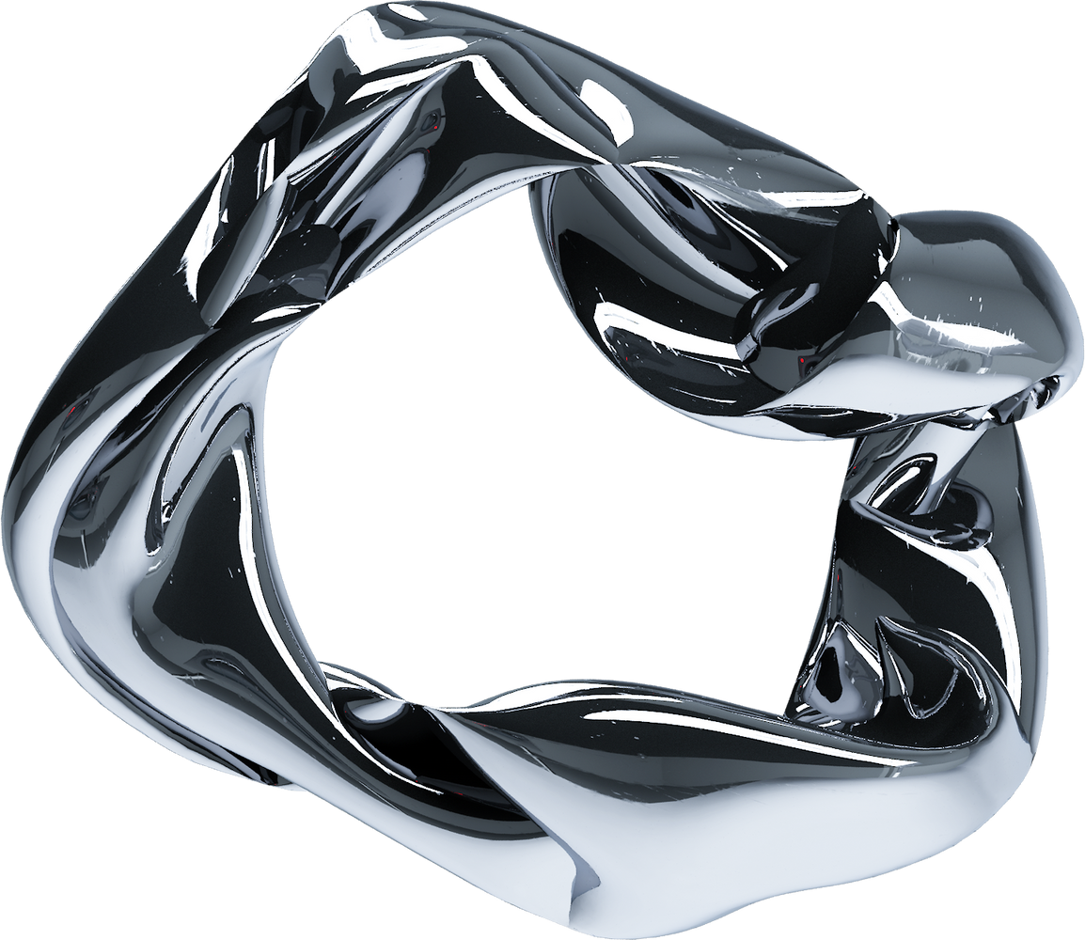
CLOUD INFRASTRUCTURE
MULTI SOFTWARE 2,0

Slide 2
MULTI SOFTWARE 2,0
This project delivers a fully cloud-native infrastructure on Microsoft Azure, designed to support secure data storage, scalable application development, centralized identity and access management, and modern DevOps practices.
WHAT WE DO

Slide 3
2. Build a secure, scalable, and fully cloud-native environment on Azure.
PROJECT OUTLINE
Cloud-first strategy on Microsoft Azure cloud without relying on any legacy systems
3. We used Microsoft Azure cloud for our solution and Draw.io for our diagram
4. Final delivery including deployment scripts, documentation, and cost analysis.
MULTI SOFTWARE 2,0

Slide 4

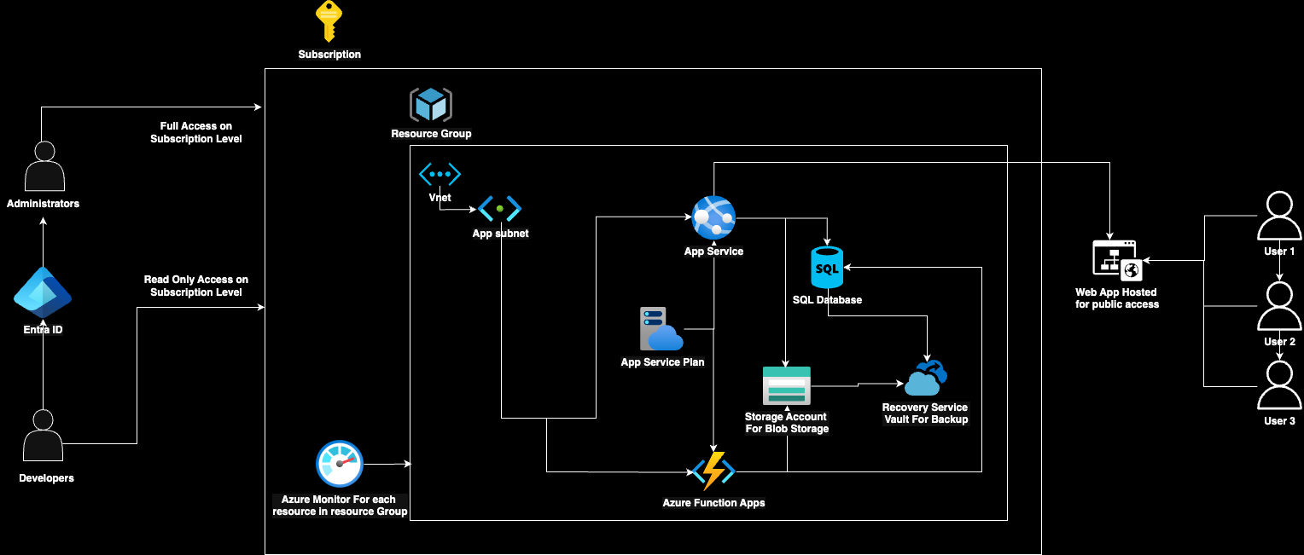
OUR GRAPH
MULTI SOFTWARE 2,0

Slide 5
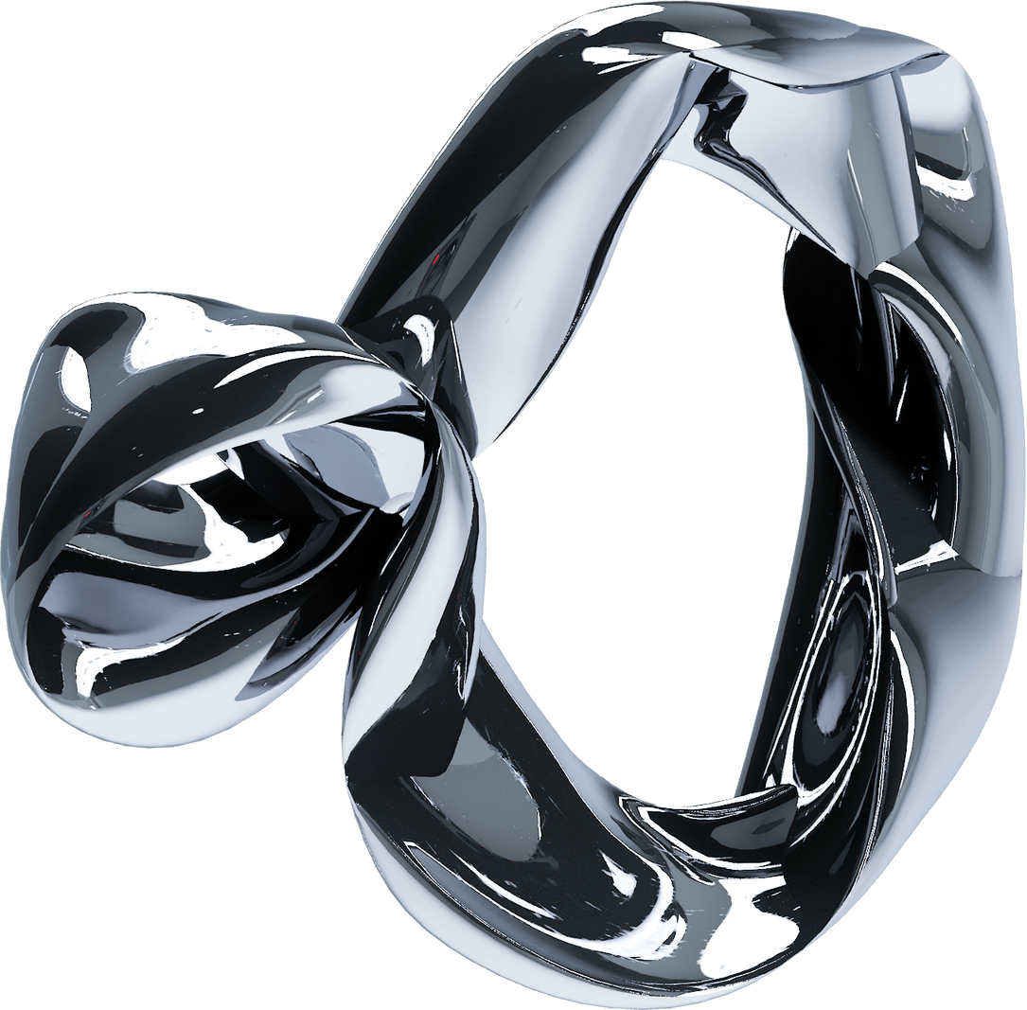
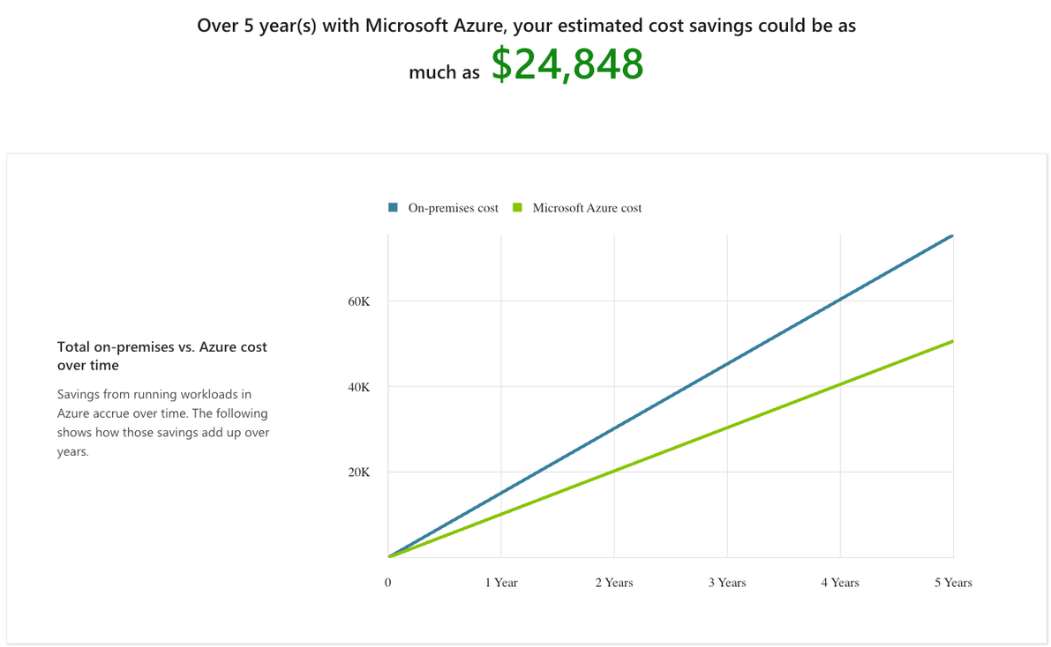

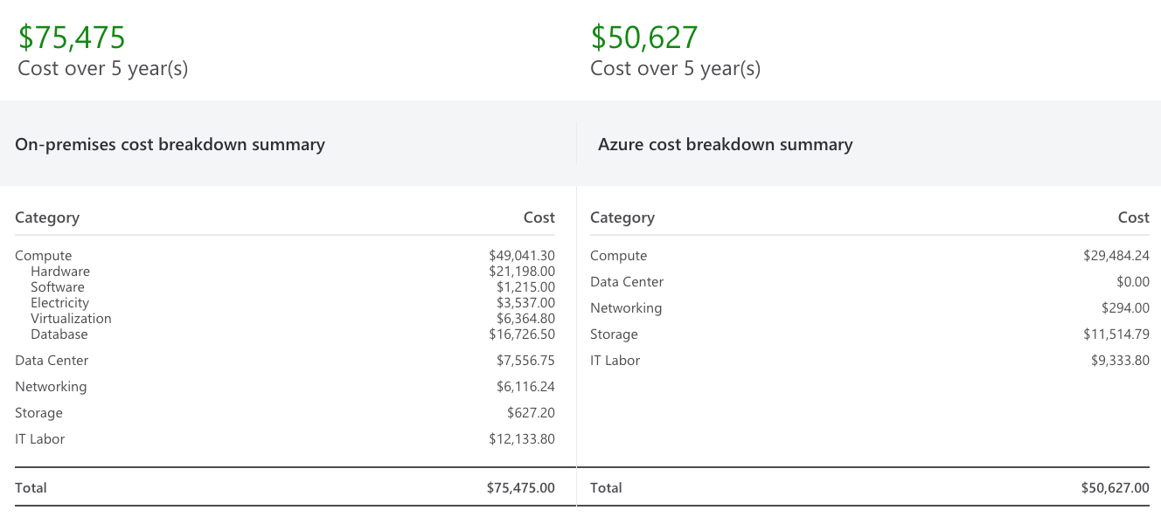
MULTI SOFTWARE 2,0
COST ANALYSIS

Slide 6
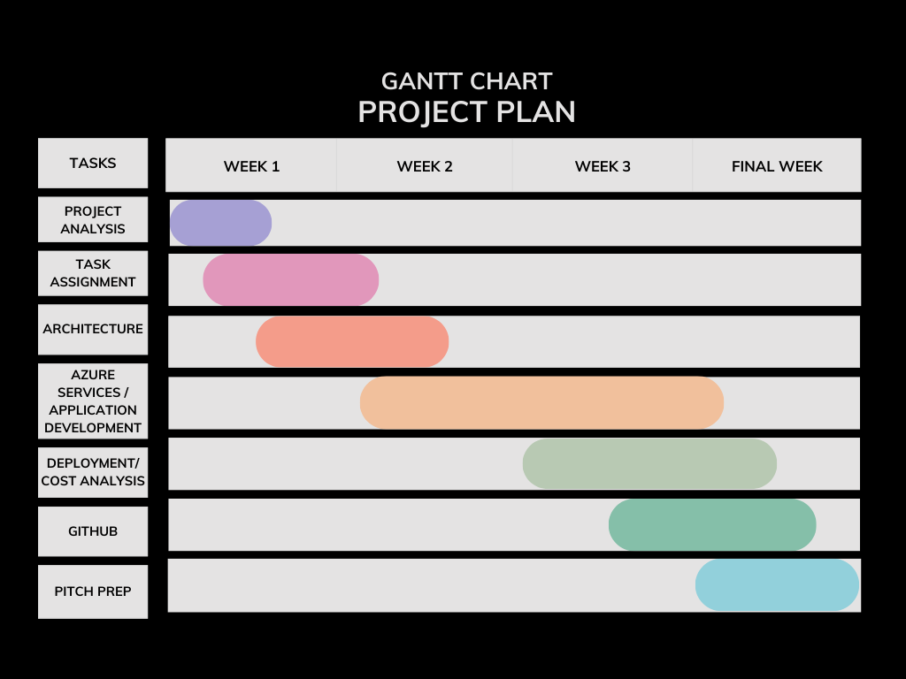
MULTI SOFTWARE 2,0

Slide 7
MULTI SOFTWARE 2,0
COLLABORATION ISSUES
Remote communication delayed the process of working on the project
Coordinating many tasks required additional time
Lack of background knowledge on azure
Reaching an agreement on azure services due to many available choices
Choosing the optimal resources to reach the most affordable plan for the company

Slide 8
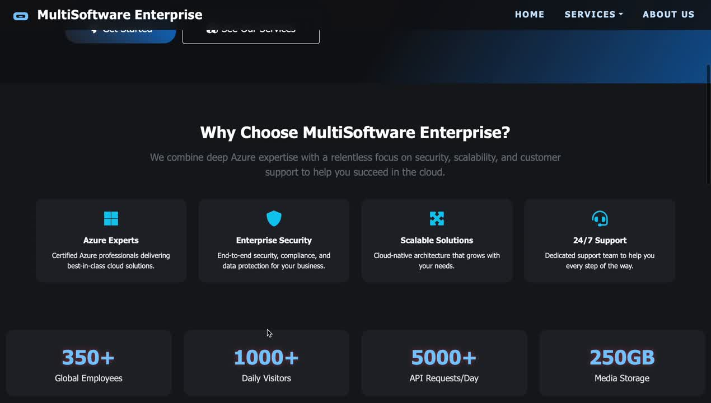
MULTI SOFTWARE 2,0
WEBSITE

Slide 9
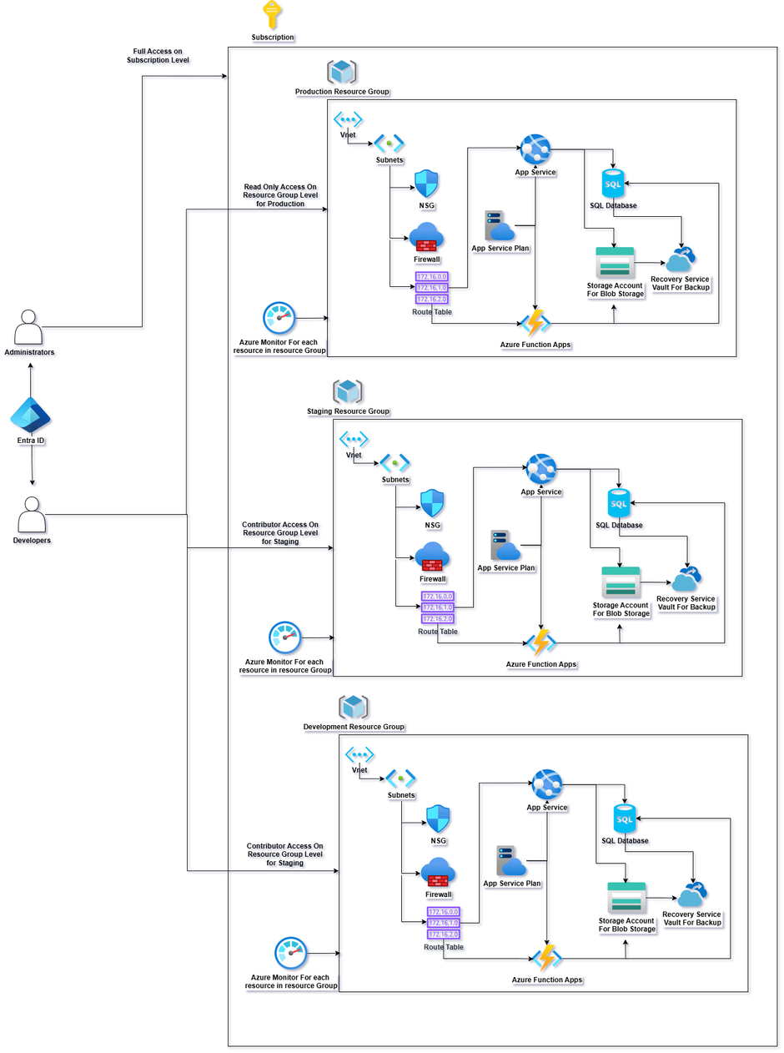
FURTHER WORK
NETWORKING & SECURITY: RESTRUCTURE USING NSG’S, ROUTE TABLES AND FIREWALL
CREATE NEW ENVIRONMENTS FOR DEVELOPMENT & STAGING
DOCKERIZED APPLICATION AND KUBERNETES USAGE FOR FULLY CLOUD SCALE.
MULTI SOFTWARE 2,0

Slide 10





OUR TEAM
MULTI SOFTWARE 2,0
Galini Babzeli
Anthi Petridou
Eirini Konstantara
Alex Doda
Argiris Gkogkidis

Slide 11
THANK YOU
MULTISOFTWARE ENTERPRISE 2,0

